Slide 1

How Quantum Computers Use Shor's Algorithm to Crack RSA
Shor's algorithm can break RSA and ECC, the public-key systems used to exchange keys and sign data.​
RSA's security rests on one assumption: factoring N = p × q is infeasible for a classical computer.​
The quantum part of Shor's algorithm only finds a period r. Every other step is ordinary arithmetic.​

Slide 2
For example
Plain text is:81, 0, 38, 71, 29, 31, 0, 82, 82, 32, 1
Public key: (e,N)=(5,91)
Before we started what is e and N?
N: is the product of two primes p and q. In real RSA both are huge
e is public. To decrypt we still need the private exponent d, which requires knowing p and q.

Slide 3

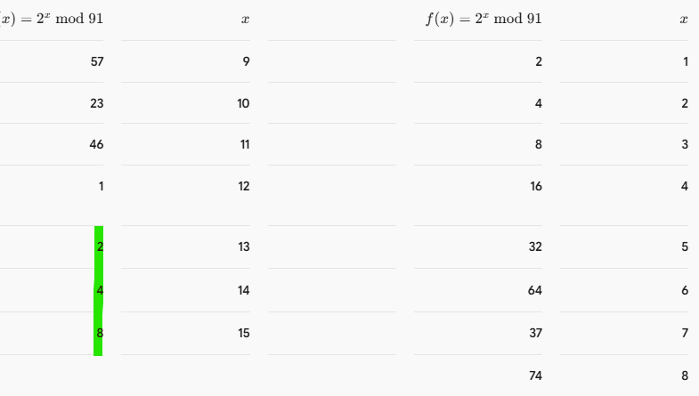
We will get p and q using Period Finding
1=gcd( a , N) in our example N= 91 then 1=gcd(a , 91) , a=2
As you can see, the values start to repeat

Slide 4




Now we get r= 12
Euler's Totient Function
=72
Why we get euler totient function?
To get d(Private Exponent)
E=5

Slide 5




Now we get d(Private Exponent)
d=29
Private Key = (d , N) = (29 , 91)
Encryption =

Slide 6
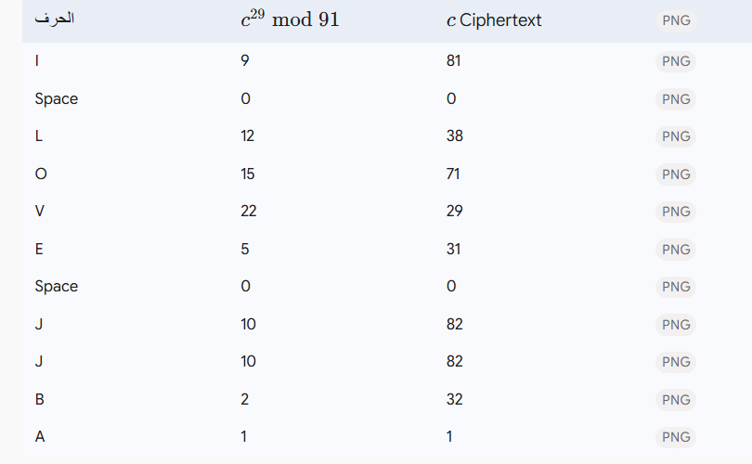
Encrypted text is = I LOVE JJBA

Slide 7
WHAT THIS EXAMPLE LEAVES OUT
numbers: N = 91 is factored instantly by anyone. Breaking a 2048-bit N needs a large fault-tolerant quantum computer.​
Harvest now, decrypt later: data recorded today could be decrypted once such a machine exists.​
Defense: post-quantum algorithms standardized by NIST, such as ML-KEM and ML-DSA.​

Slide 8
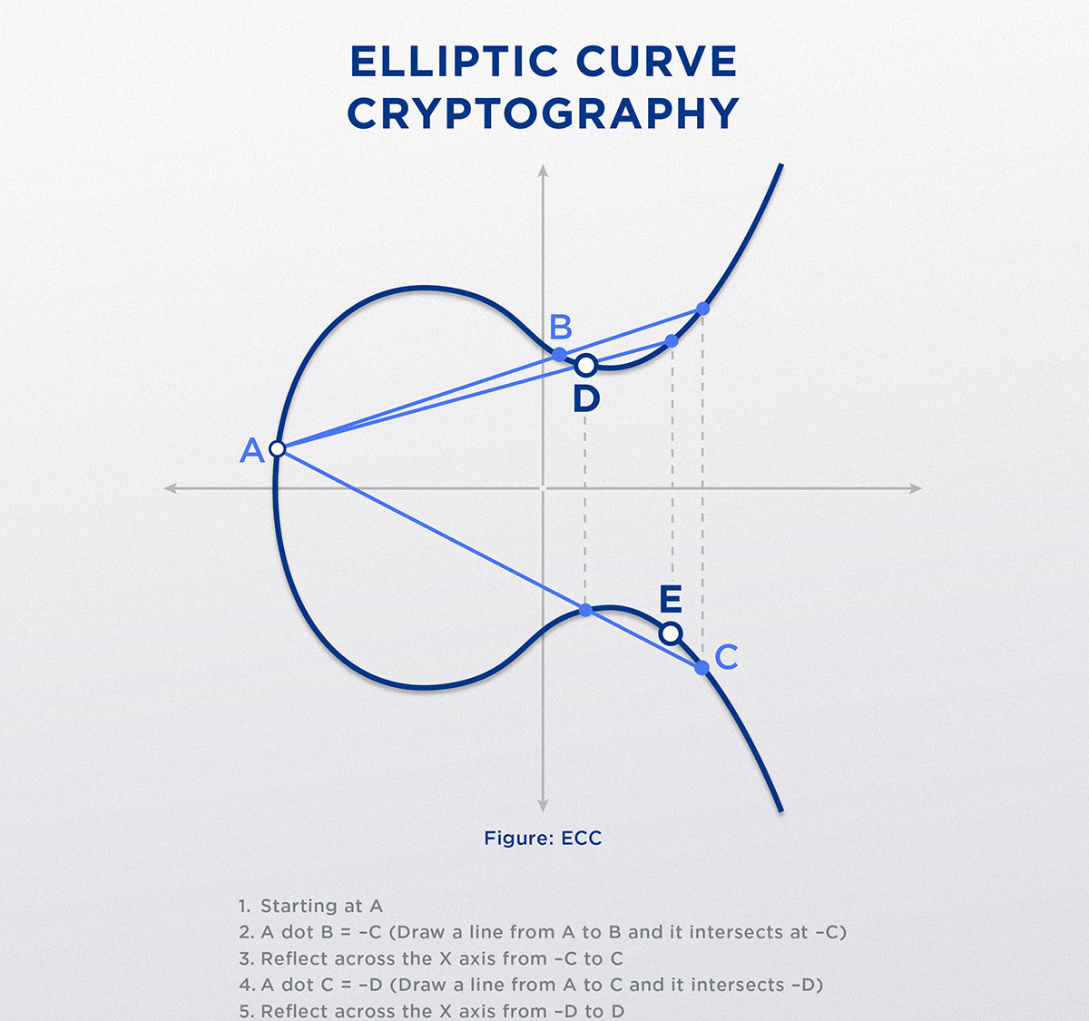
How Quantum Computers Use
Shor's Algorithm to Crack
ECC

Slide 9
ECC: THE SAME MESSAGE, A NEW KEY
Goal: find the private key k and encrypted text.​
i | 1 | 2 | 3 | 4 | 5 | 6 | 7 | 8 | 9 | 10 | 11
C | (11,9) | (9,12) | (9,11) | (4,7) | (8,8) | (0,21) | (9,12) | (1,12) | (1,12) | (1,11) | (7,3)
Curve: y² = x³ + x + 4 mod 23 Q(public key is (10 , 5)) & R(Ephemeral Public Point(13 ,12))
First, we find the Base Point by checking the points that satisfy the Elliptic Curve equation over 23 Then we select a suitable point as the Base Point(G)
First point(0 , 0) , last point (22 , 22) for Curve: y² = x³ + x + 4
Now what point achieve y² = x³ + x + 4 mod 23
G=(0, 2) (0, 21) (1, 11) (1, 12) (4, 7) (4, 16) (6, 7) (6, 16) (7, 7) (7, 16) (8, 10) (8, 13) (9, 11) (9, 12) (11, 9) (11, 14) (13, 3) (13, 20) (15, 0) (19, 6) (19, 17) (21, 9) (21, 14) (22, 9) (22, 14)
We need to check all these points until we find the suitable one

Slide 10
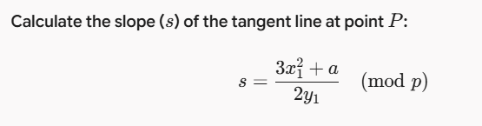


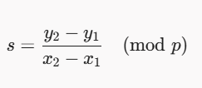


Point Doubling and Addition to Find Curve Order (n)
2P=(x3 , y3)
In our example g=(0,2) s=6 x3=13 y3=12 2G=(13 ,12)
3G = 2G + G
In our example g=(0,2) & 2G=(13,12) s=22 x3=11 y3=9 3G=(11 ,9)​
​

Slide 11


Slide 12
Public key(Q) = (10 , 5)= KG = k * (0 , 2) using point multiplication for k = 11
Ephemeral Public Point(R)=(13,12) , R=rG , 2G=(13 ,12) , r=2
Private Key S = kR = 11(13 , 12) = (15 , 17)​
We need to subtract this point from each Ciphertext Point: M=C-S
In ECC, subtraction means adding the Negative Point.
-S=(15,-17 mod 23)=(15,6)
M=C+(15,6)
C_1=(11,9) , M= (11 , 9) + (15 , 6) M=(22,5)
In G table 10G=(22 ,5) M=10G m=10-1 = 9 IT will be letter I

Slide 13
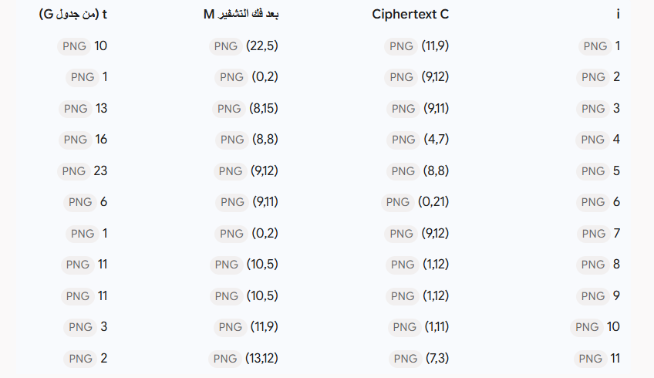
Encrypted text is = I LOVE JJBA​

Slide 14
RSA AND ECC UNDER SHOR
 | RSA | ECC
Hard problem | Integer factoring | Elliptic-curve discrete log
Shor finds | Period r of a^x mod N | Hidden period of f(a, b) = a·G + b·Q
Result | p, q, then φ(N), then d | The private key k directly
Quantum cost | Modular exponentiation of large numbers | Many elliptic-curve point additions, but keys are much shorter
Defense | ML-KEM, ML-DSA | ML-KEM, ML-DSA

